Slide 1



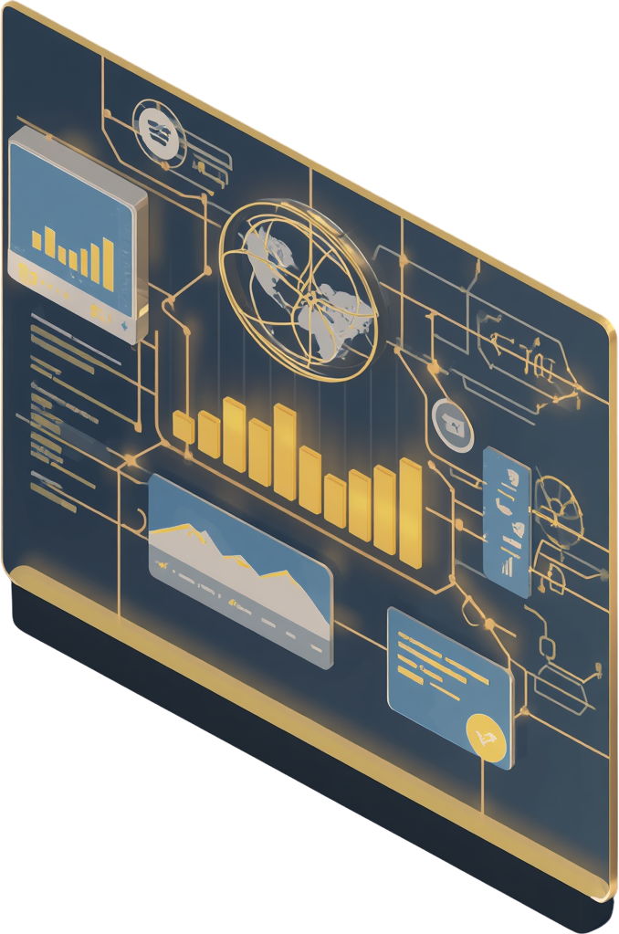
Discover Now
MARKA YOL
NLP-Powered Social Media Brand Analytics & Strategy Platform
Team Member
Elif Necla Bektaş-21030411025
Buse Nur Yıldırım-21030411012
Kevser Çalışkan-21030411032
Fakı Avcu-21030411047
Hasan Buğra Zengin-21030411049
Supervisor
Dr. Musab Talha Akpınar

Slide 2


Page 02
The Problem
Overwhelming Data Volume
Lost Insights
Brands receive thousands of social media comments daily. Manual analysis is extremely time-consuming and costly, making it impossible to keep pace with real-time feedback.
Valuable insights are buried in massive unstructured data. Difficulty extracting actionable brand intelligence and measuring sentiment impact leads to missed opportunities.

Slide 3

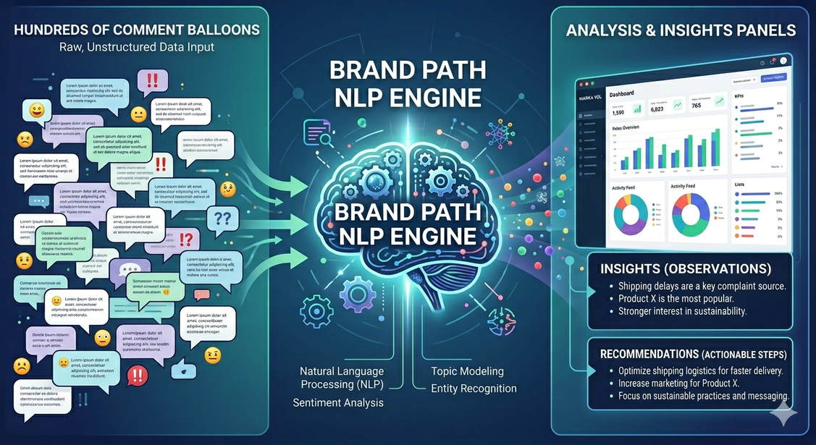
Page 03
Why MARKA YOL?
Our Value Proposition
Advanced NLP extracts meaningful insights from vast unstructured social media data. Real-time brand sentiment and trend tracking keeps you ahead. AI-driven strategic recommendations optimize your brand performance.

Slide 4

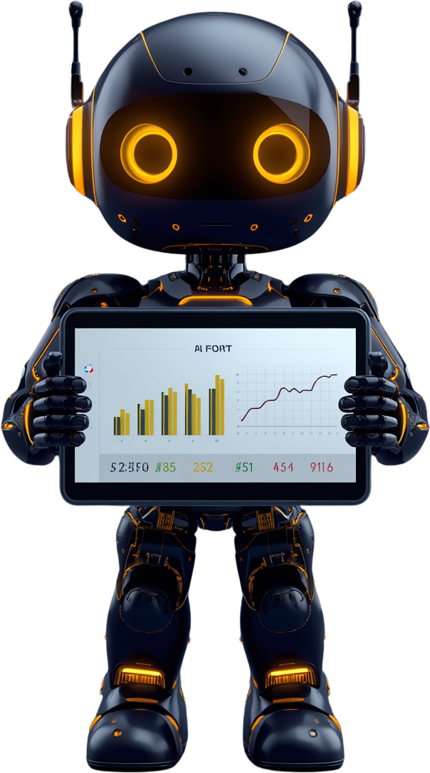
Page 04
Project Objectives
Scalable NLP engine for multi-source social media analysis (Twitter, Instagram, Facebook) with actionable brand analytics dashboards delivering real-time insights.
Data-driven strategic decision-making tools combined with a user-friendly, visually intuitive platform for marketers and brand managers.

Slide 5
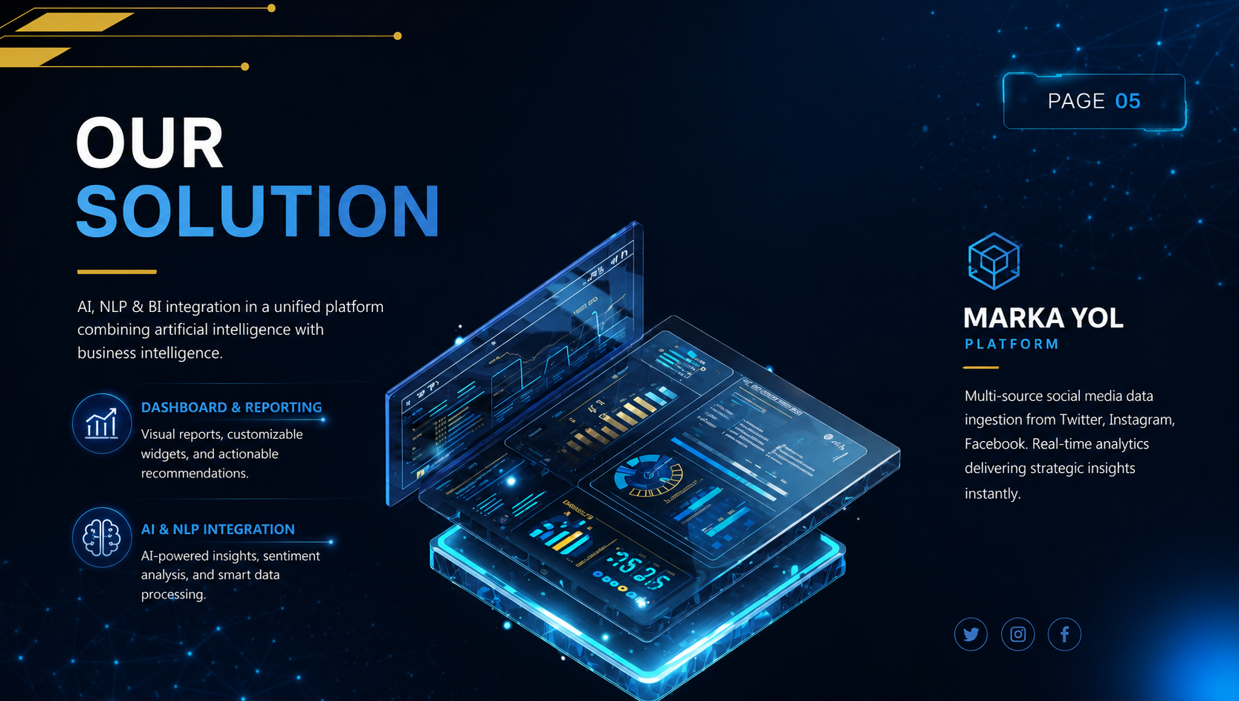

Slide 6


Page 06
Benefits for Businesses
Brand Monitoring
Strategy Impact
Enhanced reputation tracking across all platforms
Improved marketing effectiveness with data insights
Faster response to social trends and crises. Increased ROI through data-driven decisions. Real-time analytics enable proactive brand management and strategic optimization.

Slide 7

System Architecture
Page 07
"From Data Collection to AI-Powered Business Intelligence"
Social Media APIs
01
Data Collection Layer
02
AI & NLP Engine
03
Database & Processing
04
Analytics Dashboard
05

Slide 8

NLP Process
Page 08
Data Collection
01
02
Data Cleaning
Sentiment Classification
03
04
Visualization
Strategy Development
05

Slide 9

Page 09
Data Sources
Social Platforms
Data Diversity
Twitter, Instagram, Facebook provide comprehensive coverage across all major social channels where brand conversations happen.
Multi-source data ingestion enables comprehensive brand monitoring, capturing diverse audience voices and sentiment across platforms.

Slide 10


Page 10
Analyzed Brands
5 Major Brands
Cross-Sector
Trendyol, Turkcell, Hepsiburada, Garanti, THY
E-commerce, Telecom, Banking, Aviation
MARKA YOL adapts to diverse sectors and brand sizes. Our platform analyzes leading Turkish brands across e-commerce, telecommunications, banking, and aviation industries.

Slide 11
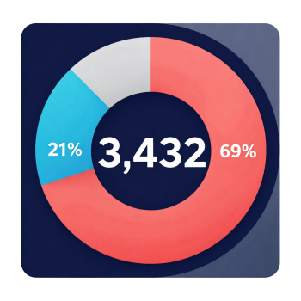
Analysis Results
Page 11
MARKA YOL NLP Analysis Results | 5 Brands | 3,432 Comments
Sentiment Analysis
Comments by Brand
Category Distribution
THY
Comment
798
1303
Garanti BBVA
Price
742
1015
Trendyol
Customer Service
665
357
Hepsiburada
Product Quality
655
275
Turkcell
Delivery/Product
295
Negative: 2,364 (68.9%)
614
Service
Positive: 721 (21%)
187
Neutral: 347 (10.1%)
Highest comments: THY (798)
Lowest comments: Turkcell (614)
Comment and price account
for 2,318 of all complaints
Total: 3,432 comments

Slide 12

Strategic Recommendations
Page 12
NLP-Based Brand Strategy Summary
TRENDYOL
A. Delivery Transparency
B. Seller Monitoring
C. Easy Returns
D. Social Media Response
TURKCELL
A. Regional Infrastructure
B. Price Transparency
C. Social Media Support
D. Positive Experience Visibility
HEPSIBURADA
A. Seller Performance
B. Product Accuracy
C. Campaign Communication
D. Customer Service Quality
GARANTI BBVA
A. Social Media FAQ
B. Digital Banking Support
C. Security Alerts
D. Chatbot & Auto-Response
THY
A. Proactive Delay Comms
B. Baggage Tracking
C. Crisis Communication
D. CS Integration

Slide 13
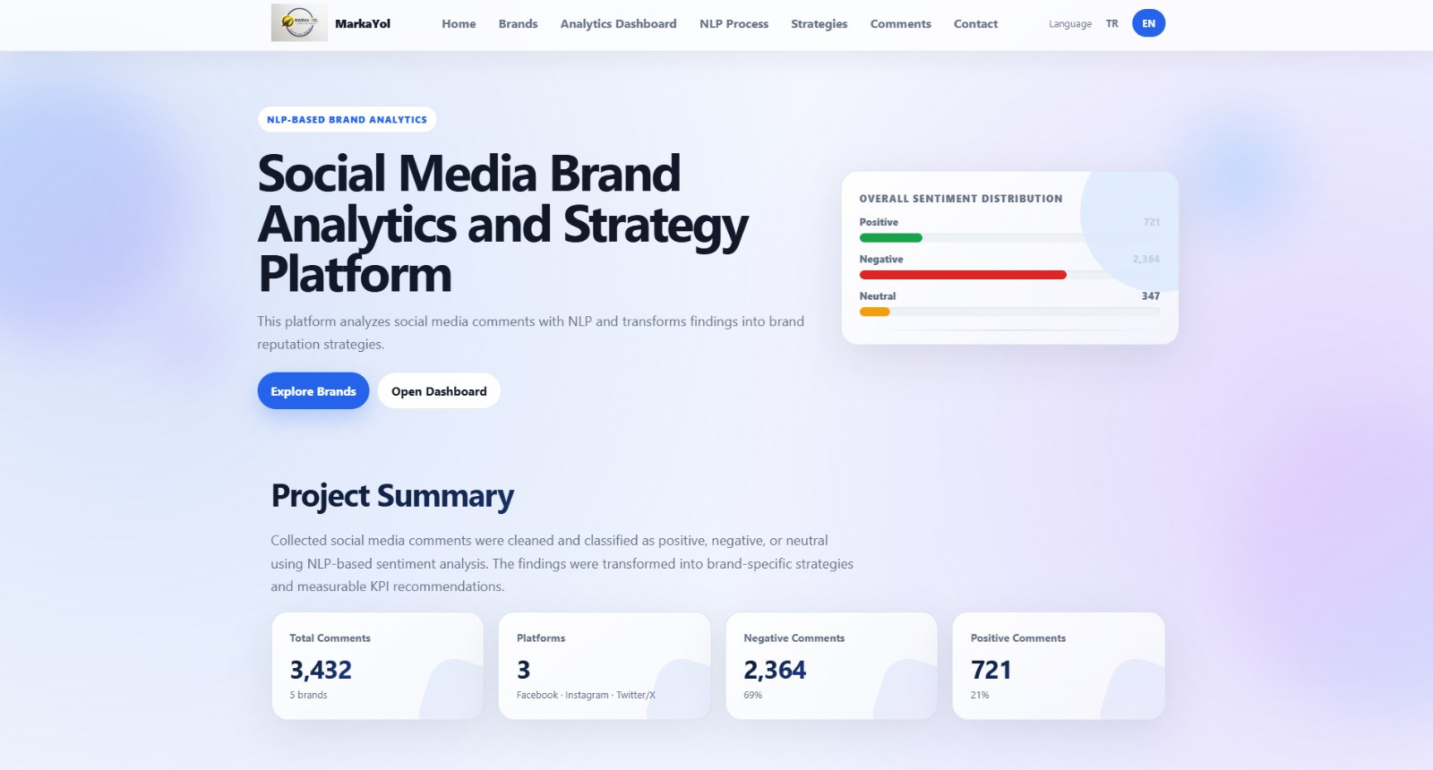
PLATFORM OVERVIEW

Slide 14


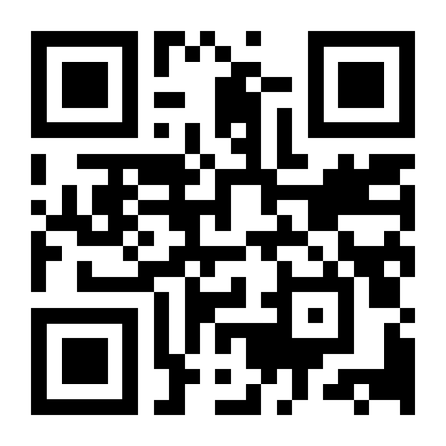
Page 14
Live Platform Demonstration
Experience MARKA YOL in action. Explore real-time NLP-powered analytics, sentiment tracking, and strategic insights. See how our platform transforms social media data into actionable brand intelligence.
https://markayol.online/
Scan the QR code or visit our platform
iletisimmarkayol@gmail.com

Slide 15

Page 15
Future Improvements
Additional Data Sources & Enhanced NLP
Expanding to TikTok and YouTube with deep learning-powered NLP for improved accuracy.
01
Predictive Analytics & Smart Recommendations
Trend forecasting capabilities with expanded customization options for strategic insights.
02
Real-Time Alert System & API Integration
Instant notifications for brand crises with third-party tool integration for seamless workflow.
03

Slide 16

Page 16
Conclusion & Questions
MARKA YOL transforms social media data into actionable brand strategies
through NLP-powered sentiment analysis and intelligent recommendations.
Data-Driven Insights
Real-Time Monitoring
Strategic Value
NLP-powered analysis of
100K+ social media comments
Live sentiment tracking
across multiple platforms
Actionable strategies that
drive measurable results
Questions?
markayol.online | iletisimmarkayol@gmail.com

Slide 17


Thank You!
Page 17
https://markayol.online/

